Slide 1
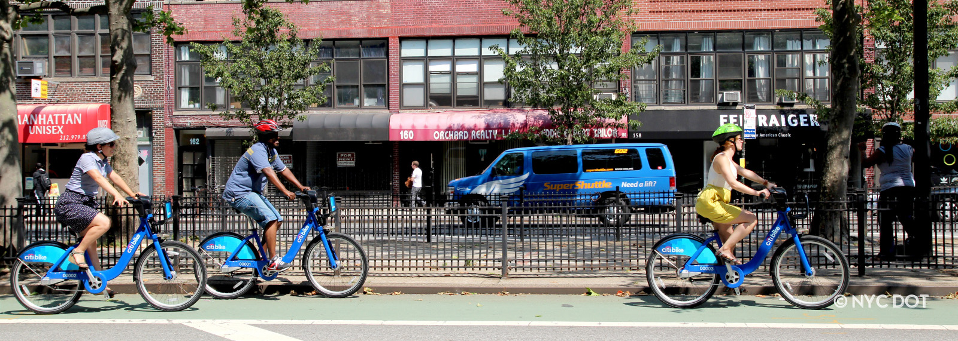
CITIBIKE: EFFECT OF WEATHER ON RIDERSHIP
DAV 6100 – SECTION 1 – GROUP 2

Slide 2
INTRODUCTION

Slide 3
ABOUT DATA
 | Citibike Trip Data | NYC Weather Data
Level of Data | Rides | Hourly
Duration | December 2023 | December 2023
Number of Records | 24,491 | 744
Number of Fields | 13 | 24
Filetype | CSV | JSON
Extraction Method | Downloadable Files | API Call
Subset | Central Park West | NYC

Slide 4
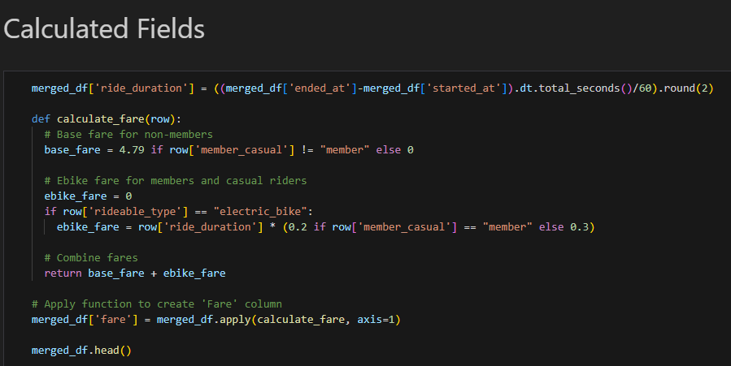
DATA PREPARATION
Citibike
Weather
Day & Hour

Slide 5
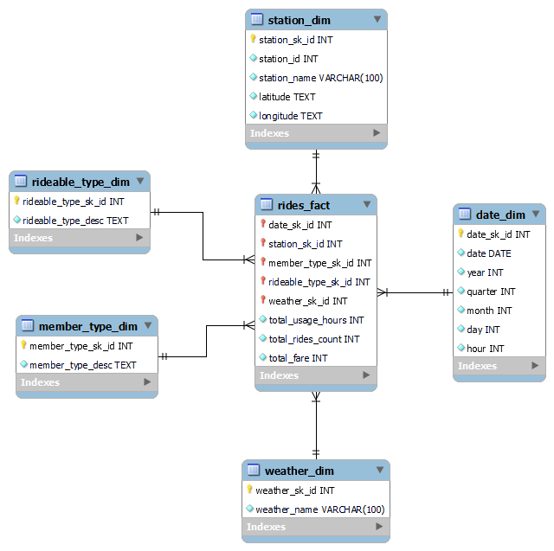
DATA MODEL
Schema: Star Schema
Dimension Tables:
Station
Date
Weather
Member Type
Rideable Type
Fact:
Details about
usage_hours,
number_of_rides,
total_fare
at hour level

Slide 6
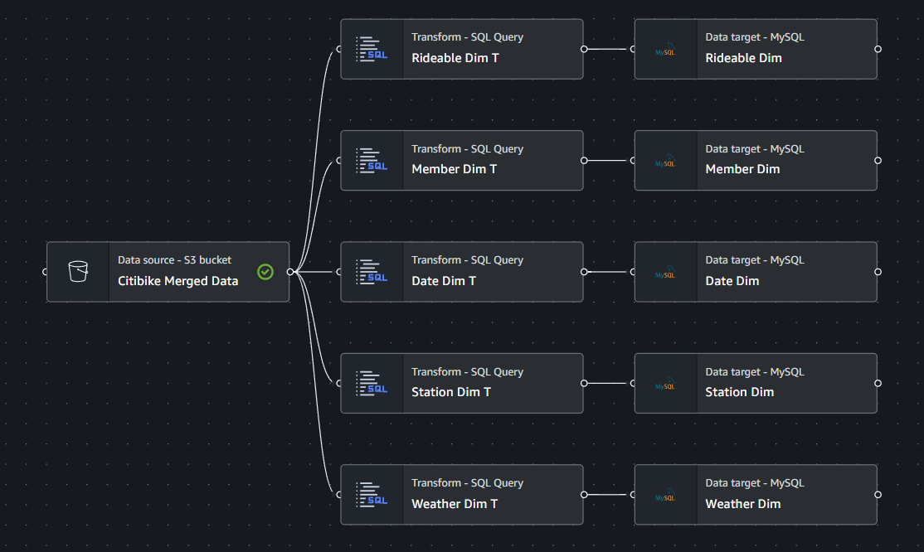
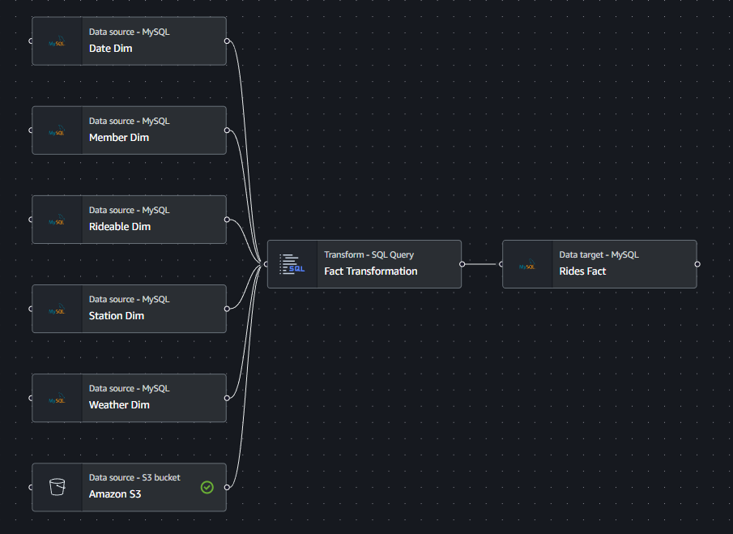
EXTRACT TRANSFORM LOAD
Dimensions
Fact

Slide 7
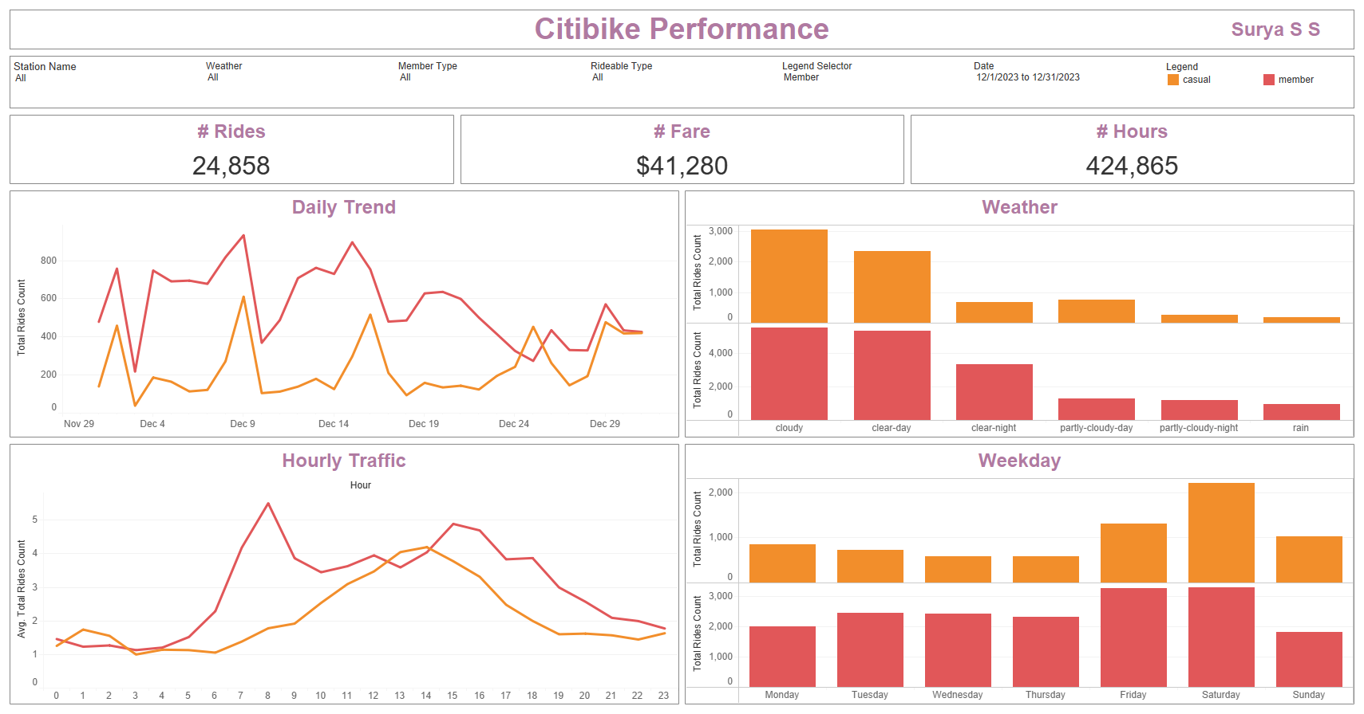
VISUALIZATION

Slide 8
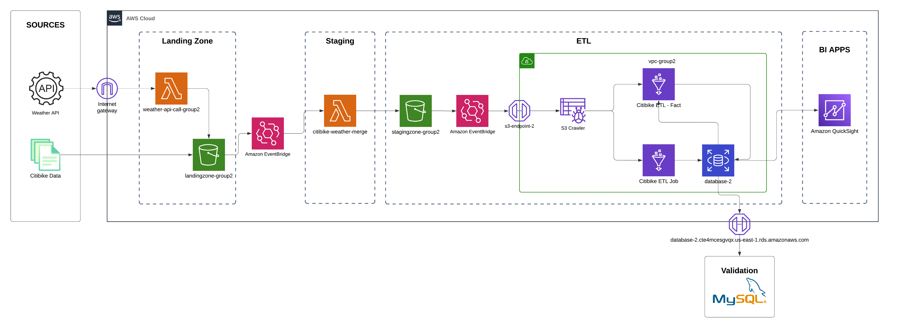
AWS ARCHITECTURE

Slide 9
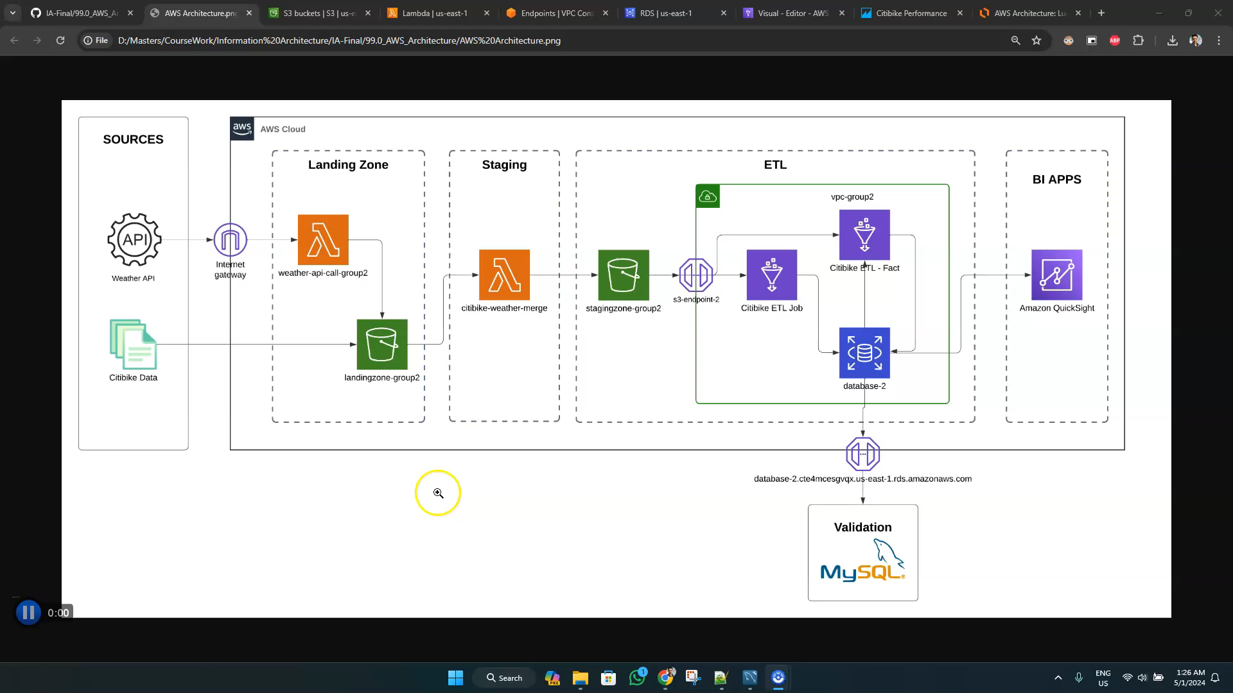
AWS DEMO

Slide 10
DOCUMENTATION

Slide 11
CONCLUSION

Slide 12
THANK YOU

